Slide 1
Community Eligibility Making High-Poverty Schools Hunger Free
Notes:
1

Slide 2
The Link Between Nutrition and Education
When a child’s nutritional needs are met, the child is more attentive in class and has better attendance and fewer disciplinary problems
The National School Lunch and School Breakfast Programs meet the nutritional needs of children by providing nutritionally balanced meals that together contain more than half of the nutrients children need each day
USDA research indicates that children who participate in the National School Lunch Program have superior nutritional intakes compared to those who bring lunch from home or otherwise do not participate
Low-income children who eat school breakfast have better overall diet quality than those who eat breakfast elsewhere or skip breakfast

Slide 3
What Is Community Eligibility?
It doesn’t make sense for high-poverty schools to go through the standard application process to identify the few children who do not qualify for free or reduced-price school meals
Healthy, Hunger-Free Kids Act of 2010 included community eligibility as a new option to allow high-poverty schools to feed more students and focus on meal quality rather than on paperwork
Community eligibility is designed to be extremely easy for a school or district to adopt and became available nationwide in the 2014-2015 school year

Slide 4
Benefits of Community Eligibility
Lessens administrative work – schools no longer have to collect and verify school meal applications and can focus on feeding children.
Increases participation— when all children can eat at no charge, stigma is eliminated and more children participate.
Facilitates implementation of breakfast after the bell—schools don’t have to collect fees or count each meal served by fee category, simplifying implementation of service models that boost participation.
Improves the financial viability of school nutrition programs—when participation increases, school districts can take advantage of economies of scale, and reinvest additional revenue to improve meal quality.
Eliminates unpaid meal fees—when all children eat at no charge, the school district does not have to collect unpaid fees from families.

Slide 5
Community Eligibility Implementation
In the 2015-2016 school year:
Nearly 3,000 school districts are participating (1 in 5 districts nationwide)
More than 18,000 schools are participating (just over half of all eligible schools and 1 in 5 schools nationwide)
Nearly 9,000 of the highest-poverty schools are participating (roughly 2 in 3 of the eligible highest-poverty schools)
As a result, 8.5 million children have access to two healthy meals at school each day (1 in 6 school children nationwide)
There was tremendous variation in the extent to which states implemented community eligibility.

Slide 6
Map: Percentage of Eligible Schools Adopting Community Eligibility SY 2015-2016

Slide 7
Community Eligibility Implementation in [YOUR STATE] in SY 2015-2016
In [Your state]:
____ of _____ eligible schools adopted community eligibility
____ of _____ eligible school districts adopted community eligibility
____ of _____ eligible highest-poverty schools adopted community eligibility
______ students attend community eligibility schools
[Note: to find the number of schools that have adopted community eligibility and the number of schools eligible visit: http://frac.org/pdf/take-up-of-cep-report.pdf]

Slide 8
How Community Eligibility Works
High-poverty schools provide free breakfasts and lunches to all students without collecting applications
Any school district can use this option if at least one of its schools has 40 percent or more students certified for free meals without application (called “Identified Students”)
Schools with a 40 percent Identified Student Percentage often have 75 percent or more of their students qualifying for free or reduced-price meals
The district may implement community eligibility in one school, a group of schools or district-wide
By May 1 of each year states must publish lists of all schools that are eligible for community eligibility and all schools that are near-eligible
To participate for the 2016-2017 school year, school districts must notify the state agency by August 31, 2016 (this is a deadline extension)

Slide 9
Who Are “Identified Students”?
Children certified for free meals without submitting a school meal application
Includes children who are directly certified (through data matching) for free meals because they live in households that participate in the
Supplemental Nutrition Assistance Program (SNAP)
Temporary Assistance for Needy Families Cash Assistance (TANF)
Food Distribution Program on Indian Reservations (FDPIR), or
Medicaid (in districts participating in USDA’s demonstration project)
Includes children who are certified for free meals without application because they are
in foster care
in Head Start
are homeless or
are migrant

Slide 10
Reimbursements Under Community Eligibility
% Identified Students x 1.6 = % meals reimbursed at “free” rate; the rest are reimbursed at “paid” rate
Example: a school with 50 percent Identified Students would be reimbursed at the free rate for 80 percent of the breakfasts and lunches it served (50% x 1.6 = 80%) and the remaining 20 percent would be reimbursed at the paid rate
Participating schools are guaranteed to receive the same reimbursement rate (or a higher one if the Identified Student Percentage increases) for 4 years
Therefore, the higher the poverty level (Identified Student Percentage), the higher the reimbursement rate.

Slide 11
Meal Reimbursements with Community Eligibility
The reimbursement rate for both lunch and breakfast is determined by multiplying the percent of Identified Students by a 1.6 multiplier. The resulting number is the percent of meals reimbursed at the “free” reimbursement rate, with the rest reimbursed at the “paid” rate.
Percentage Identified Students | Percentage Free | Paid
40% | 64% | 36%
45% | 72% | 28%
50% | 80% | 20%
55% | 88% | 12%
60% | 96% | 4%
65% | 100% | 0

Slide 12
Community Eligibility Take-up is Greater in the Highest-Poverty Schools SY 2015-2016

Slide 13
How School Districts Can Participate
By individual school
Individual schools with 40% or more Identified Students participate in community eligibility
By group
Districts may choose to group schools any way they wish and calculate the free claiming percentage for the group of schools as a whole, using their combined enrollment and total number of Identified Students, as long as the percentage is 40% or higher
There is no limit to the number of groups
Within the same school district, some schools can participate individually and some can participate as a group
By school district
All schools in the district participate as a single group with the same free claiming percentage as long as it is 40% or higher

Slide 14
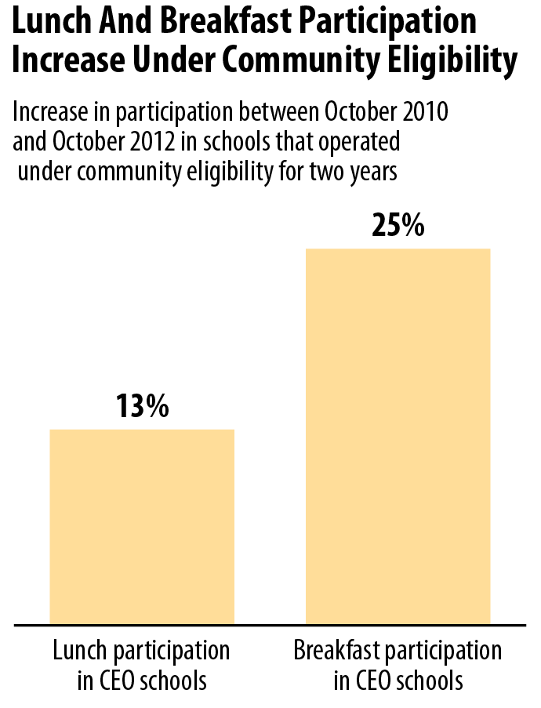
Lunch And Breakfast Participation
Increase Under Community Eligibility
Notes:
Increase Participation (and reduce plate waste)
14

Slide 15
Feedback From Community Eligibility Schools
All school districts that implemented the option the first year and were surveyed by FRAC would recommend community eligibility to high poverty schools like their own
School districts report positive feedback from parents and school staff
Increased ability to feed more students
Some districts report an increase in revenue
Notes:
15

Slide 16
Breakfast In The Classroom
Community eligibility helps schools build stronger breakfast in the classroom programs by making it easier for schools implementing alternative service models — like “grab and go” — to offer breakfast to all students at no charge.
West Virginia requires all community eligibility schools to implement at least one innovative breakfast strategy — breakfast after the bell, breakfast in the classroom, or “grab and go” breakfast — participation increased by 10 percent
Breakfast participation doubled in Floyd County, KY when it implemented community eligibility and breakfast in the classroom simultaneously
When Detroit, MI adopted community eligibility, even though it had already implemented breakfast in the classroom in all K-8 schools, breakfast participation increased by 15 percent
Notes:
16
16
16

Slide 17
Community Eligibility Resources
Key Materials
http://frac.org/community-eligibility/
www.cbpp.org/cep
USDA Community Eligibility Resource Center
http://www.fns.usda.gov/school-meals/community-eligibility-provision
FRAC Facts: Community Eligibility
http://frac.org/pdf/community_eligibility_amazing_new_option_schools.pdf
Database of Eligible and Participating Schools
http://frac.org/may-2016-community-eligibility-provision-searchable-database/
Community Eligibility Adoption Rises for the 2015-2016 School Year, Increasing Access to School Meals
http://frac.org/pdf/take-up-of-cep-report.pdf

Slide 18
Contact Information
Jessie Hewins
jhewins@frac.org
202-986-2200 x 3966
www.frac.org
Zoe Neuberger
neuberger@cbpp.org
202-325-8757
www.cbpp.org
Notes:
18

